Slide 1
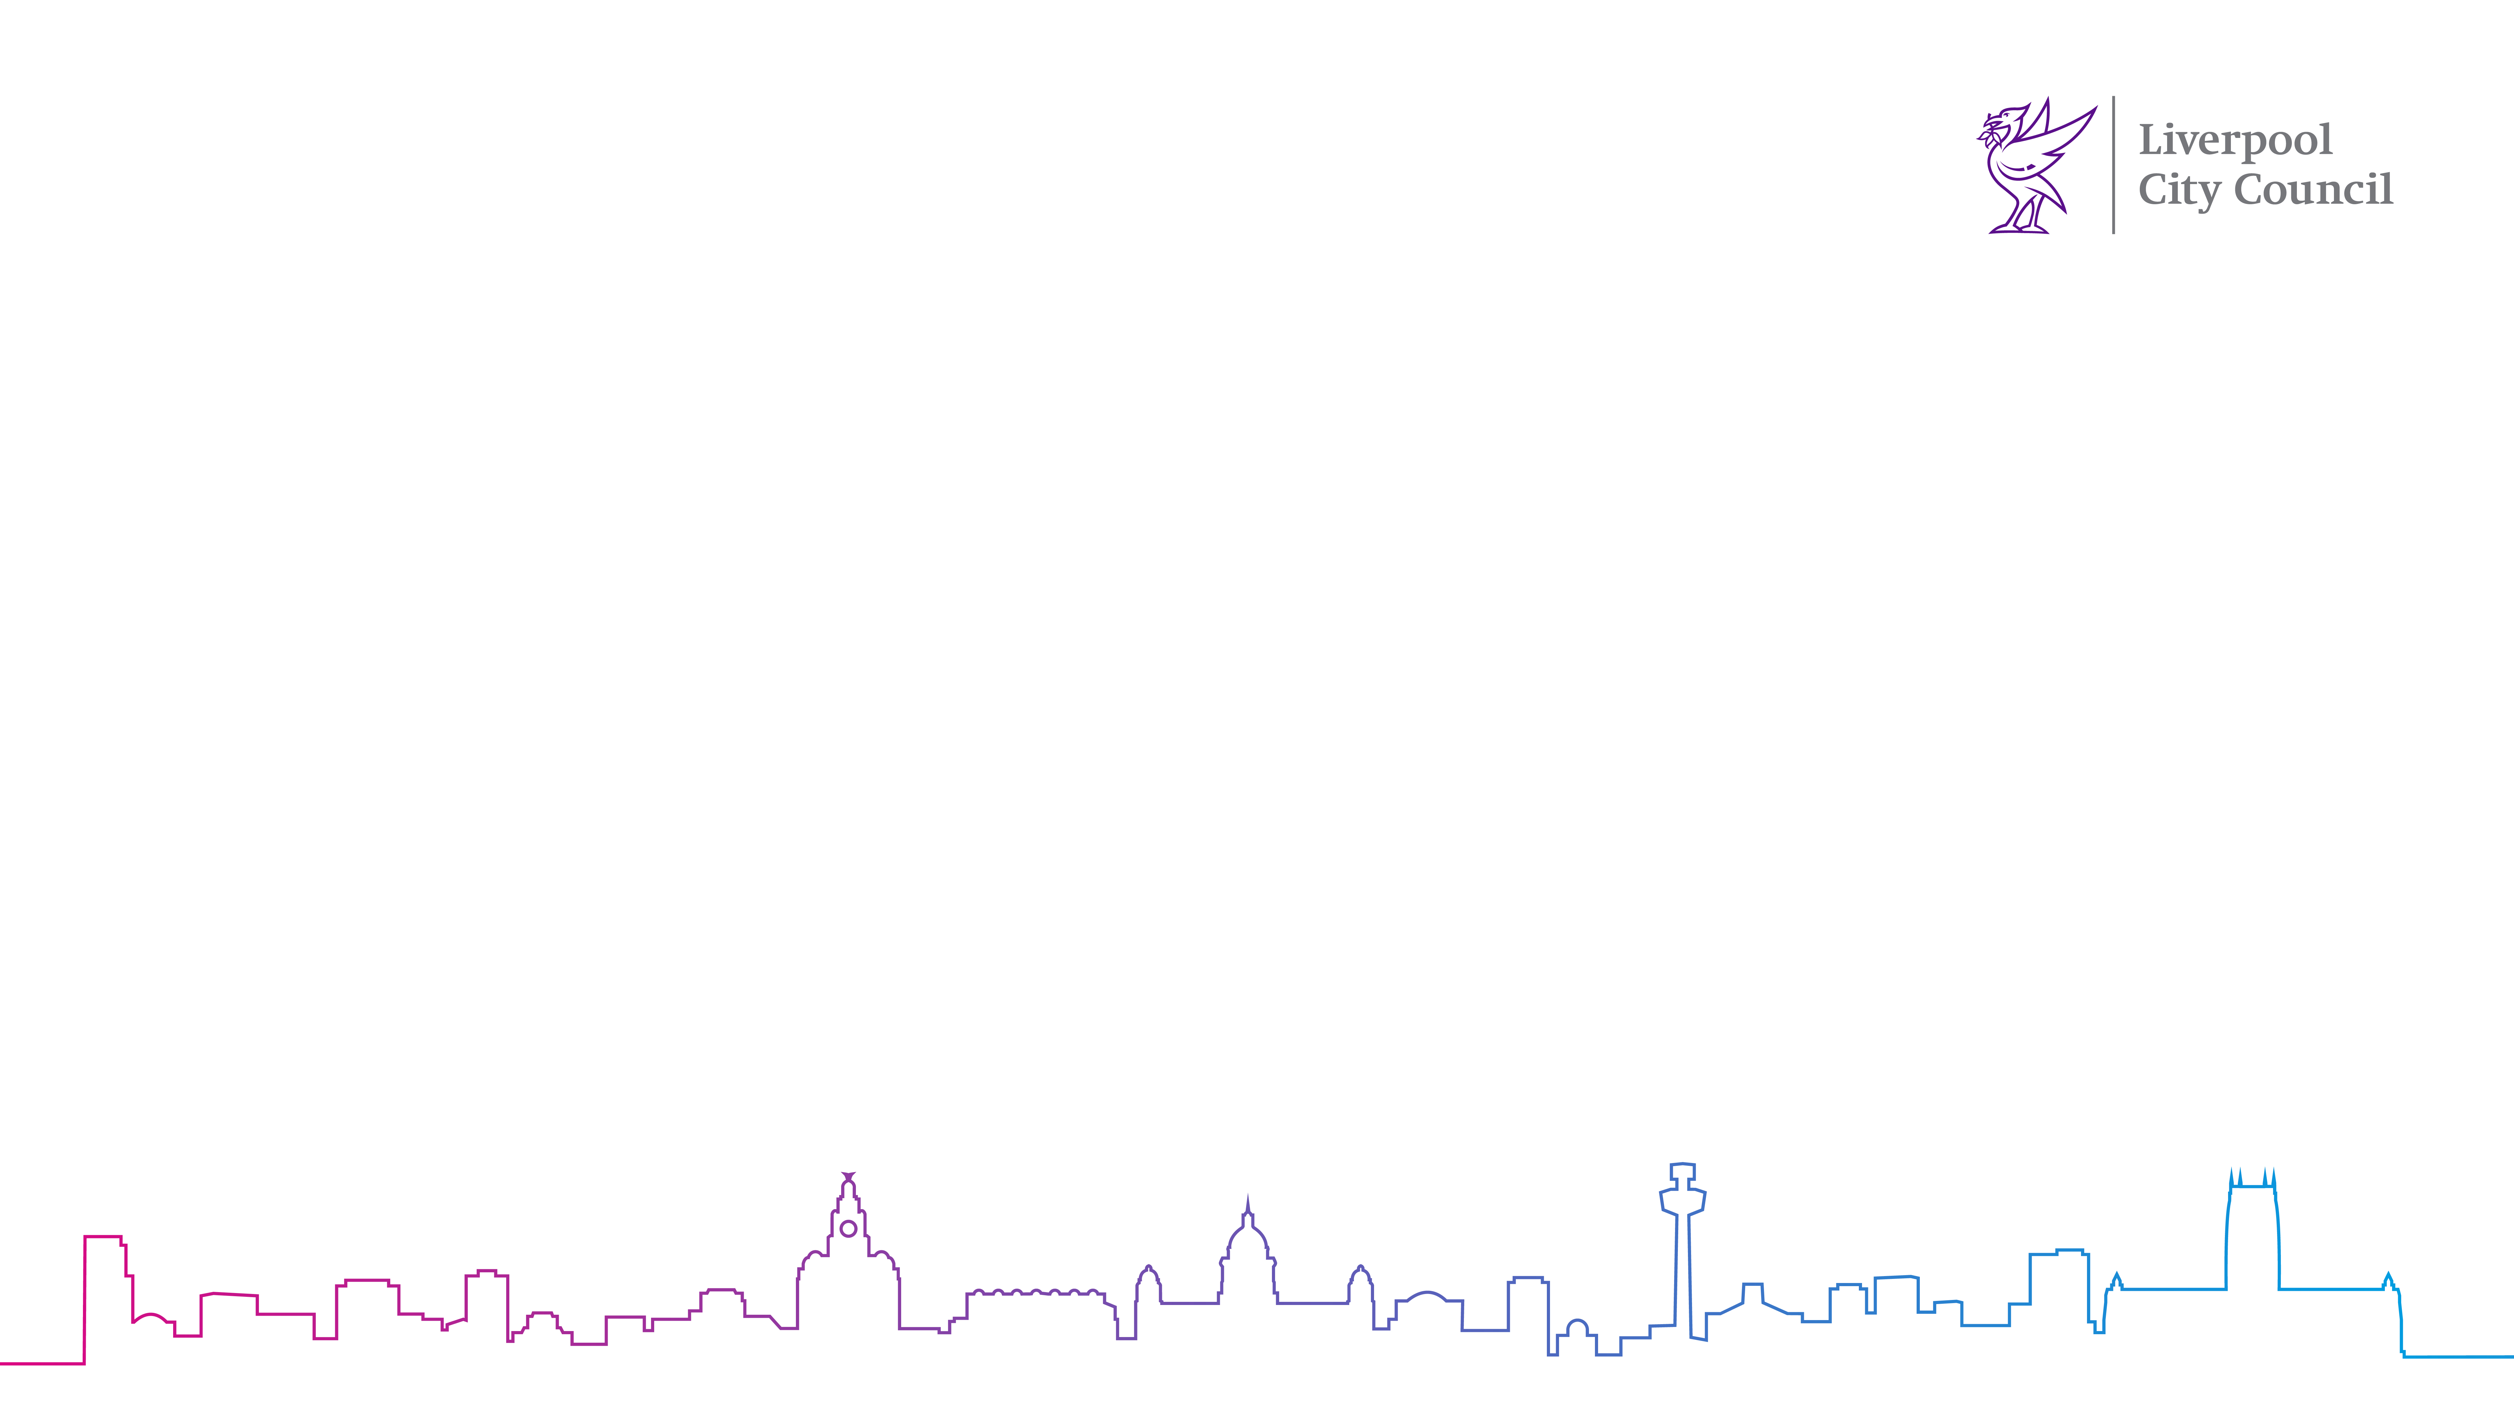
Starting School
Check your child’s immunisations are up to date.
Your child will be learning and playing with more children when they start school.
This means they could be at risk of catching infections if they are not up to date with all their childhood immunisations.
Some of these infections can be very serious, e.g. measles.

Slide 2
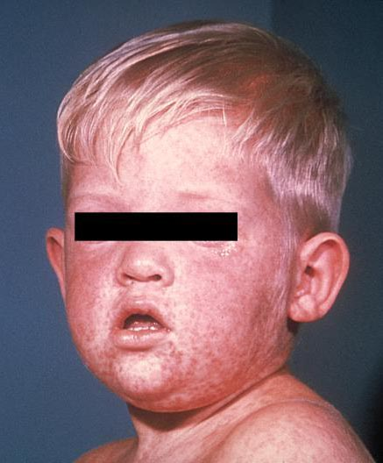
Measles can be very serious. It weakens the immune system for 18 months after catching it. It can lead to serious problems if it spreads to other parts of the body, such as the lungs or brain.
Problems that can be caused by measles include:
pneumonia
meningitis
blindness
seizures (fits)

Slide 3
Pre-school jabs
Your child needs to have had 2 doses of MMR to protect against measles, mumps and rubella
and be up to date with all of their routine immunisations.
The 1st dose of MMR is given around their 1st birthday and the 2nd dose is given at aged 3 years and 4 months.
It is never too late to catch up if your child has missed an immunisation.
Check the Red Book or contact the GP practice if you are not sure.

Slide 4
MMR is very safe and effective, and it is free.
There is a lot of false information on the internet about immunisations. For good information, see the NHS website:
https://www.nhs.uk/vaccinations

